Slide 1

LionWeb:
Standards for Models Interoperability
Meinte Boersma / DSL Consultancy
& Pedro J. Molina, PhD. / Metadev

Slide 2
Content
Problem
LionWeb
  Repository
  Serialization format
  LionCore
  Bulk Protocol
  Delta Protocol
Roadmap: derived Models
Enabling Technology → Use Cases
Conclusions
Call to action

Slide 3
Problem
MDE(/MBSE) brings many advantages
Some day-to-day problems also arise in the industry:
  Disparity of tools with no easy path for integration
  Lack of interoperability and vendor lock-in
  Obsolete tools
  Fragmented models

Slide 4

LionWeb
Language Interfaces on the Web — https://lionweb.io/
An open-source project to define
  standards to make it easy to interchange models between different tools
  integrate tools in real-time
  and provide a durable exchange mechanism over time
Standards are backed by implementations

Slide 5
LionWeb: Repository
Model Repository
Provide an API for:
  storing parts (partitions) of models
  query models
  subscribe to model changes

Slide 6
LionWeb: Serialization format
Serialize models as simple-to-process JSON
  Works for any modeling language defined through LionCore M3
  Fault tolerant/resilient

Slide 7
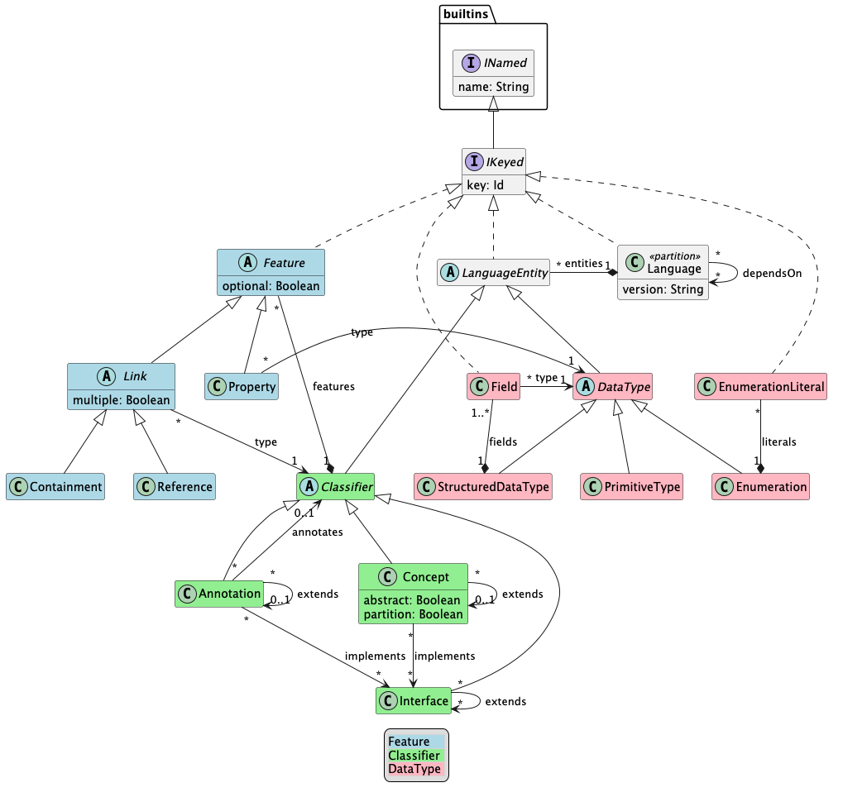
LionWeb: LionCore M3
The meta-metamodel that ensures languages share a common shape.

Slide 8
LionWeb: Bulk Protocol
For high-efficiency, isolated reads and writes of massive model partitions.

Slide 9
LionWeb: Delta Protocol
Continuous, granular updates and real-time, multi-client collaboration.
  Loosely based on CQRS: queries + commands → events.
  Can also be used to synchronize a distributed model.

Slide 10
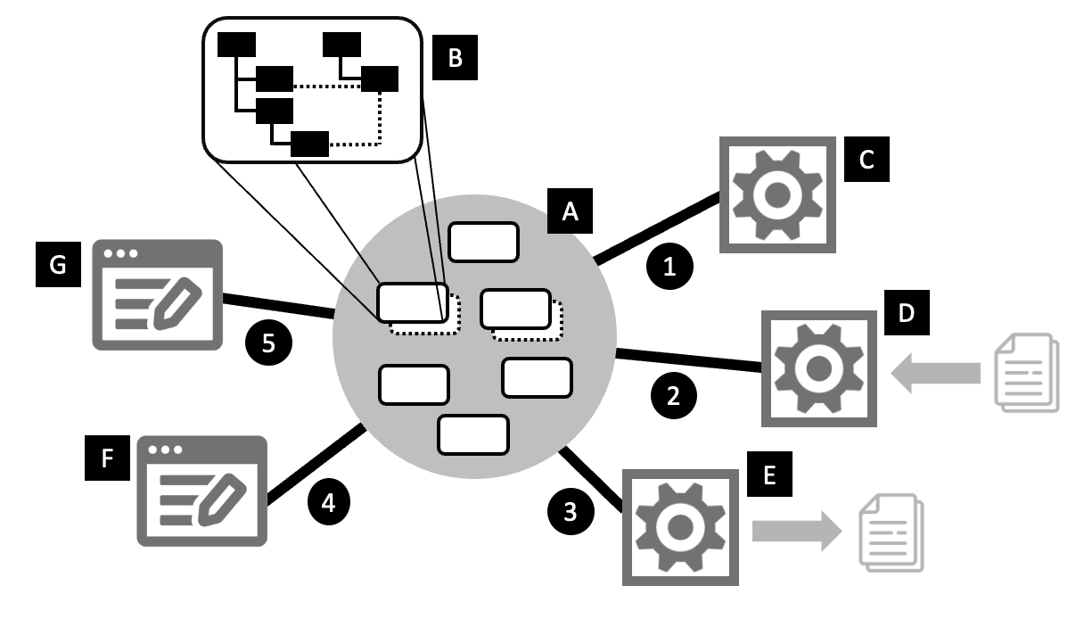
Roadmap
Derived Models
Enrich existing information suitable for receivers, with traceability
Formalism: declarative calculations
Development starting Q4 2026

Slide 11
Demo: space!
Components
LionWeb server + admin UI — TypeScript
Model loader — C#
Model validator — C#
Simple web client — TypeScript
Cool web client — TypeScript (Daga)

Slide 12
Enabling technology
Use Cases
Integrate modeling tools from different vendors
  Producers, validation, enrichers, transformations, projections, consumers via Bulk API
Integrate real-time modeling tools from different vendors
  Via Delta Protocol
Standardize storage and access for big arbitrary models
  Reference Repository implementation
Migrate models from older versions to new ones in a standardized way
  Schema Evolution support
  Ecosystem of tools
  “LionWeb inside”: Open source and commercial implementations
  Editors, parsers, model repositories, model-transformation engines, validators, code generators, visual editors, projectional editors, in many stacks and languages. Ensemble your modeling IDE with the suitable COTS to your use case.

Slide 13
Conclusion
Open, maturing standards for modeling
Growing ecosystem of tools across platforms:
  Java, .NET, TypeScript, Kotlin, JetBrains MPS, Python
Growing support from companies:
  Strumenta, F1RE, DSL Consultancy, Metadev (Daga), Freon

Slide 14

Call to Action
Take a look: https://lionweb.io/
Use it: https://github.com/lionweb-io
Collaborate:
  Slack — join via https://join.slack.com/t/lionweb/shared_invite/zt-2k1k5bsv7-EvC2IABIgSxWrqJNVOZ0HQ
  Open Office Hours first Friday every month

Slide 15
Q&A
https://lionweb.io

